Slide 1

Pillai hoc college of engineering and technology
Online descriptive and subjective examination
Presented by- saurabh singh
Shlok nakti
Milind jamkhandi
Guided by- dr.anitha patil

Slide 2
INTRODUCTION
Online descriptive or subjective are becoming internal part of many universities.
The process of examination, assessment, result preparation and formulation of question paper to judge different level of knowledge is an integrated approach entirely.
The research paper is organized as starting with different types of examinations patterns in form of online, offline and manual examination.
1

Slide 3
WHY ONLINE EXAMINATION?
STORED REPOSITORY OF EXAMS.
GENERAL PROBLEM WITH TIME FOR STUDENTS.
AUTO GRADING.
TIME SAVER.

Slide 4
OBJECTIVE
Online examination will reduce the hectic job of assessing the answers given by the candidates manually.
Being an integrated Online examination system it will reduce paper work.
To allow automatic grading and manual grading which can be recorded per test.
Random generation of test question Timed exams.

Slide 5
PROBLEM DEFINITION
Quick display of the evaluated answers are not available which leads to loss of time for students.
Examiner needs to carry booklets, question paper ,the theft of the booklet or question paper would create nuisance and disorder in the exam.
This process involves a lot of responsibility on the examiner. Loss of character in any of the role of these persons would not be desirable and fair.
The corrected booklets and answer papers need to be preserved properly and maintained, loss of these sources would be problematic for the students.

Slide 6
EXISTING SYSTEM
An online tool that tackles test requirements with friendly interfaces and descriptive answer evaluation.
The proposed system for descriptive answer evaluation is based on text mining technique which involves keyword matching ,sequence matching and quantitive analysis and semantic analysis.
General structure of text analysis in natural language processing most of the work has been done for morphological and syntactic analysis but semantic , pragmatic and discourse are still being explored.
1

Slide 7
PROPOSED SYSTEM
The proposed system will allot marks according to percentage of accuracy present in the answer.
The entire process consists of three main steps: keywords and synonyms extracting , matching of keywords, weighting the keywords and generating score,
This system is divided in 3 roles :administrator aspect, department aspect , student aspect..
The standard answer is stored in the database the system will evaluate each answer by matching the keywords and key concepts as well as its synonyms with the standard answer.

Slide 8
PROPOSED SYSTEM ARCHITECTURE

Slide 9
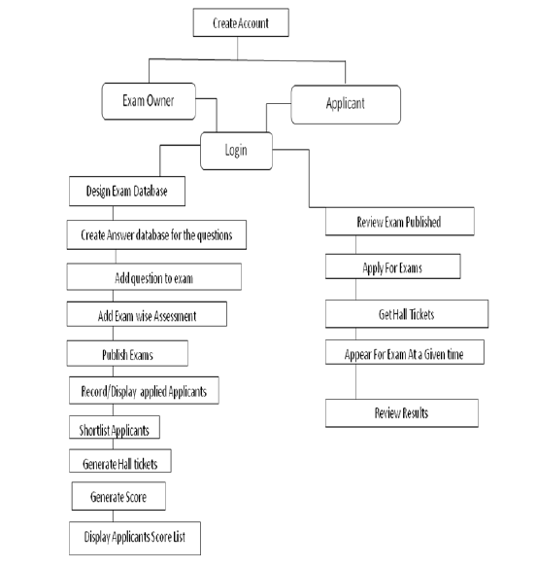
FLOW CHART

Slide 10
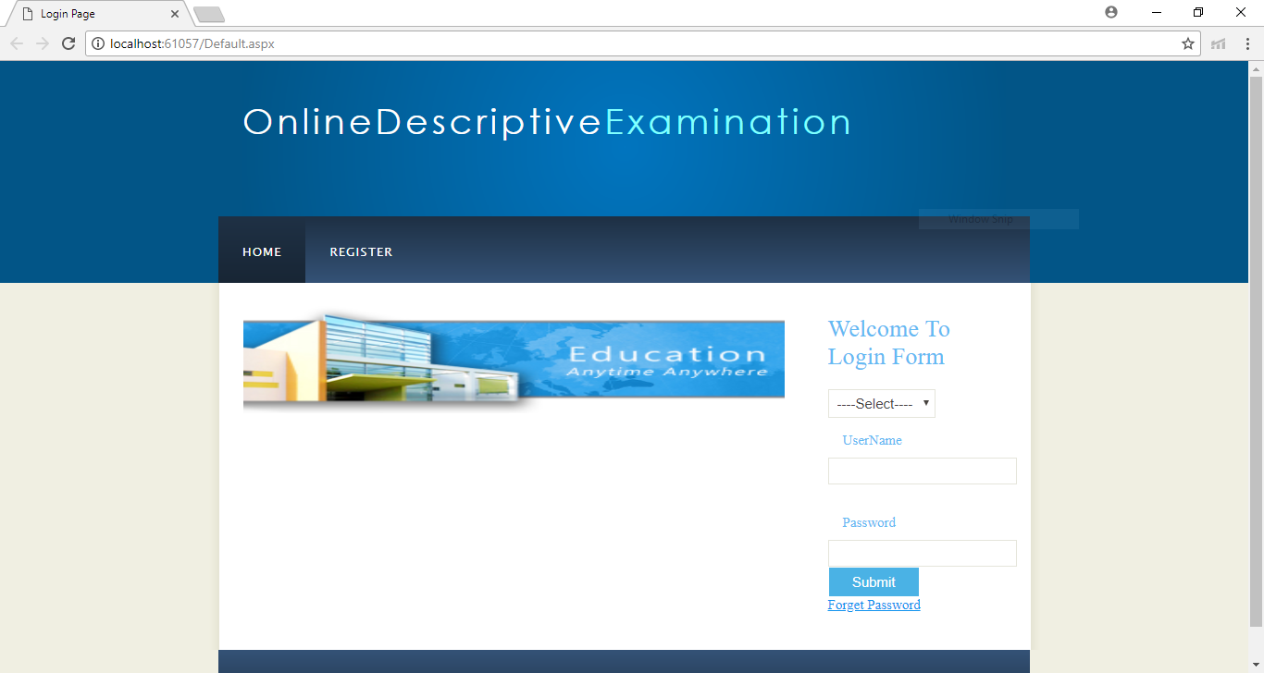
Implimentation

Slide 11
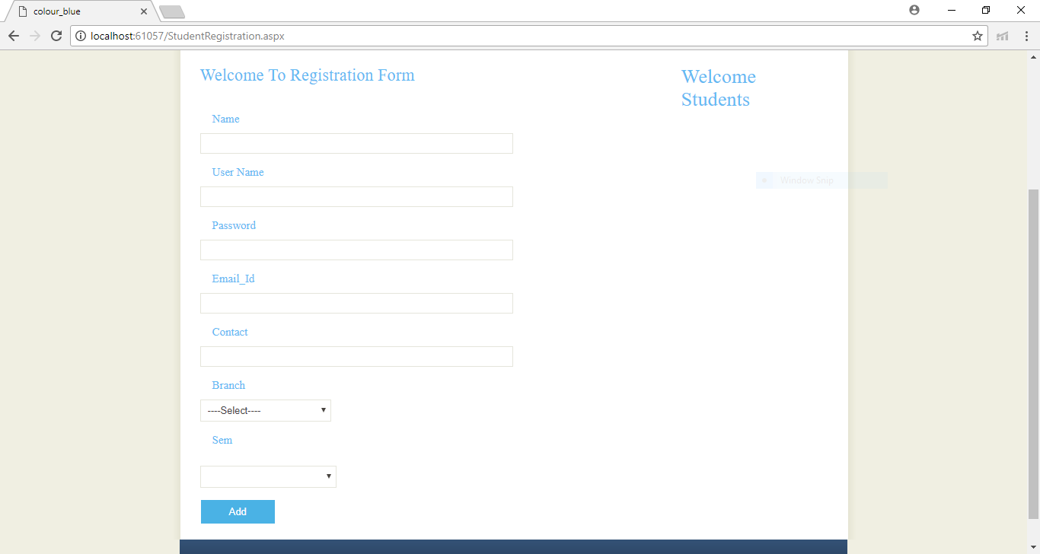

Slide 12
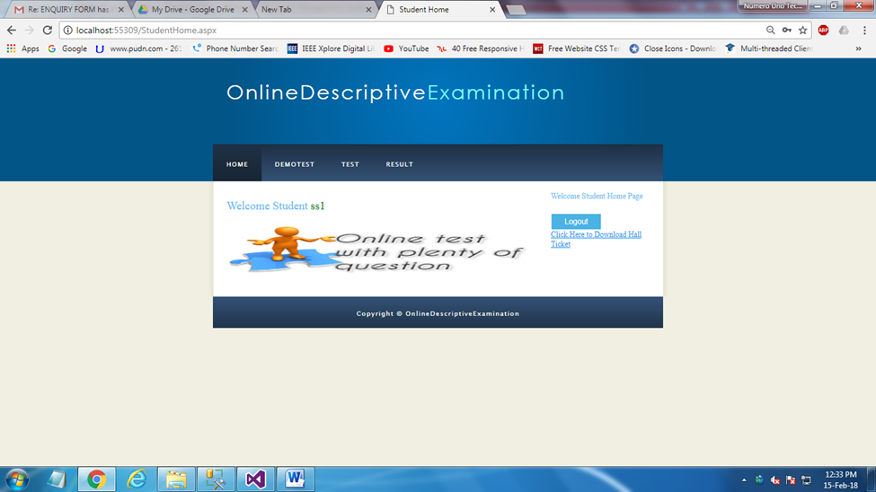

Slide 13
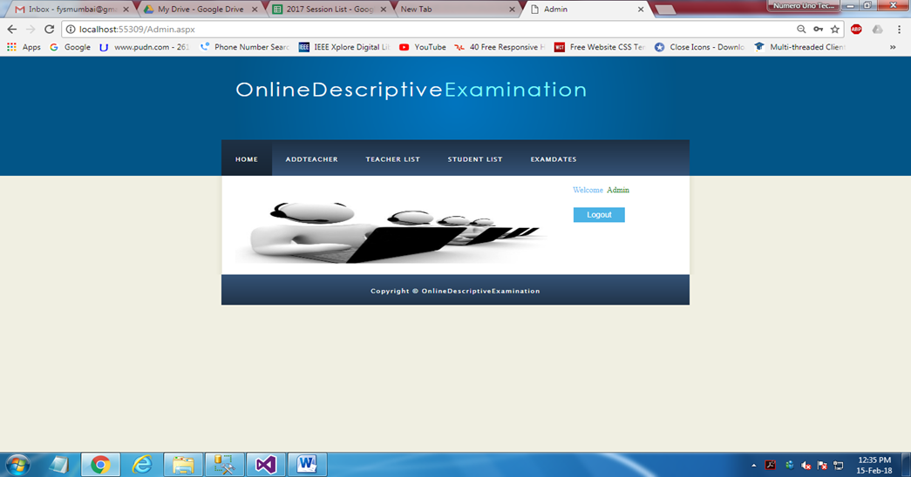

Slide 14
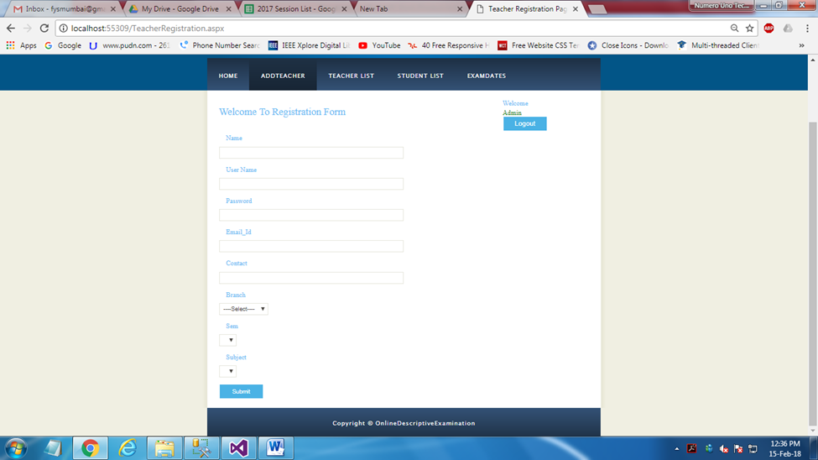

Slide 15
CONCLUSION
With the proposed system, candidates can answer their examination on digital answer paper and submit the digital answer paper to the server directly from where it can be accessed for human evaluation system or automatic evaluation system.
This process will reduce the tedious job of the examination boards, examination centers and the invigilators.
This project has tremendous potential for implementation at large scale. With subsequent research, the system may be adopted by all organisations as well as at university level.
It would save enormous amount of man hours for evaluation of examinations and would also save time, effort and paper and help to overcome other limitations of manual evaluation.

Slide 16
REFERENCES
[1] A relevant online examination system,2010 International Conference on Technology for Education
[2] Design and Implementation of Online Exam System Based on Data Mining , icicis
[3] Interactive Items-Based Online Examination System, (iTAP)
[4] Design and Implementation of Hybrid Examinations for the Academic Education using Tablet PCs.
1

Slide 17
THANK YOU !

